Slide 1
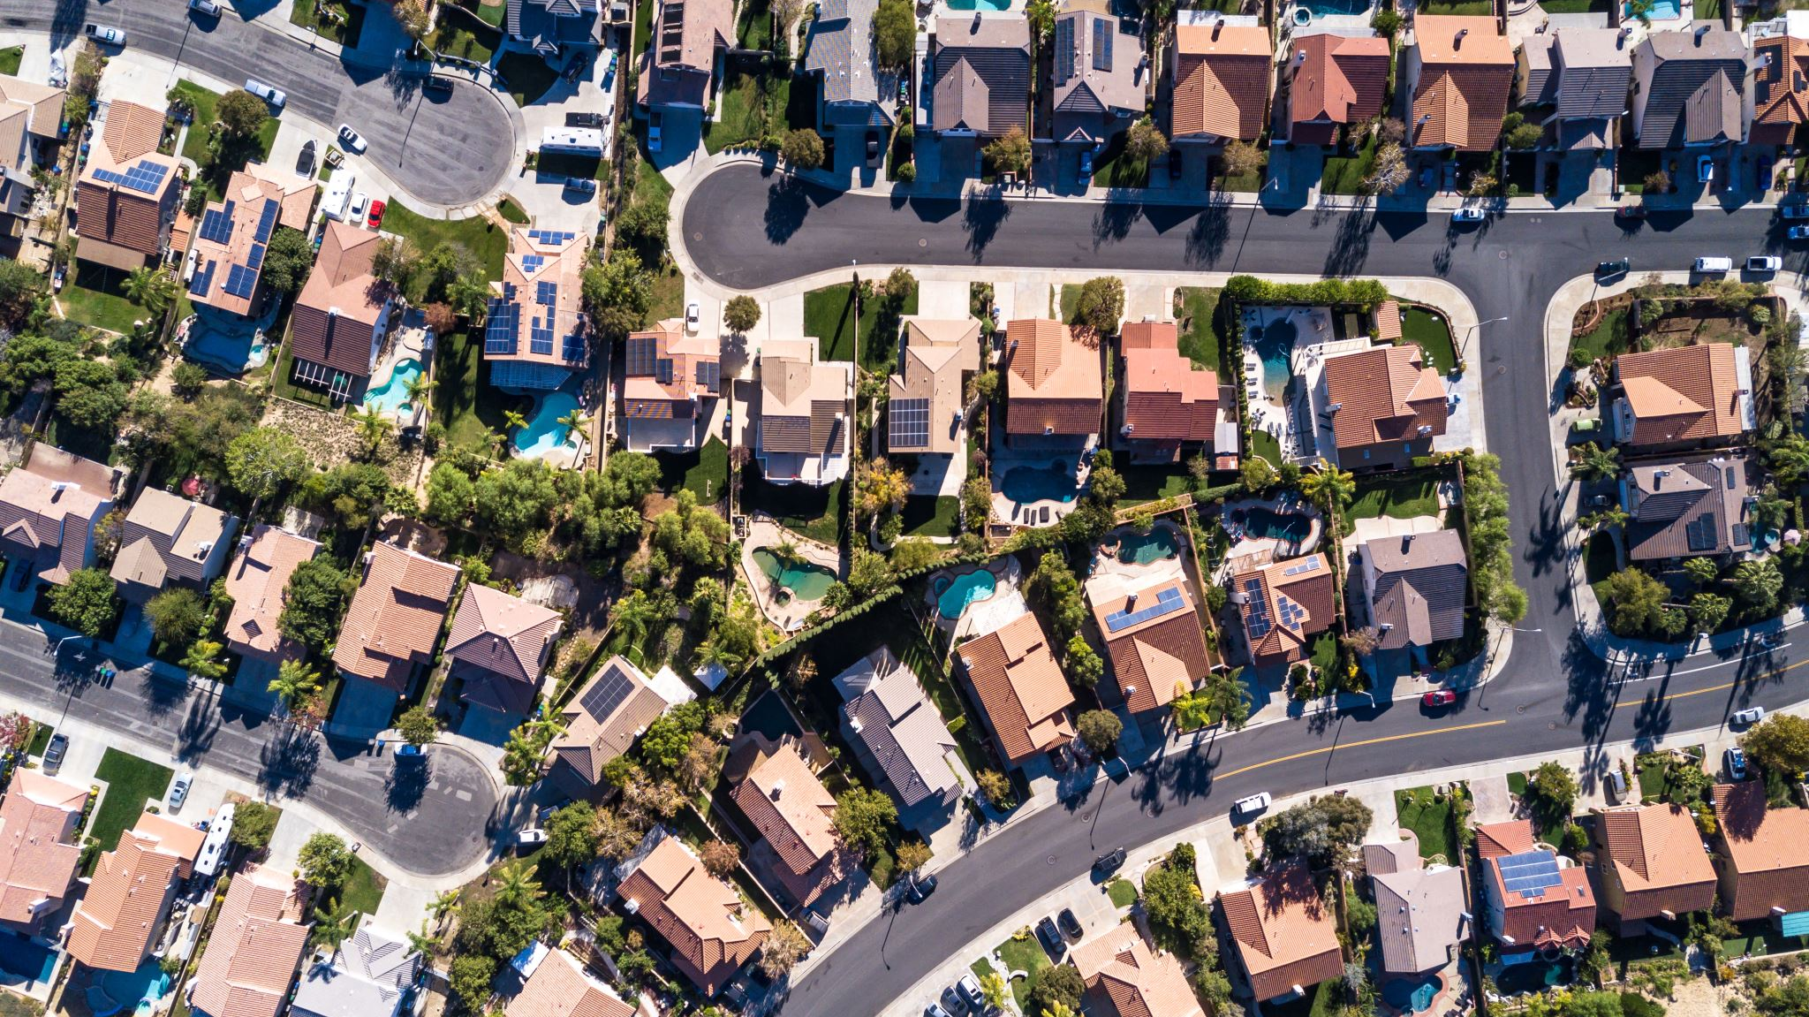
California Housing Market Trends 2018 to 2023
Group 2
Madison Hamby, Brianne Han, Josh Mares, and Kyle Novak

Slide 2
Analysis Goal
Conduct a comprehensive analysis of housing market trends

